Slide 1
Data Visualization
Name
Institution of Affiliation
Course number
Professor
Date

Slide 2
Introduction to data visualization
Data visualization refers to the graphical representation of information and data
Data visualization tools are important in data analysis
Visualization data is easy to present and understand
It is not cumbersome and simplifies the presentation pattern hence attractive to the reader

Slide 3
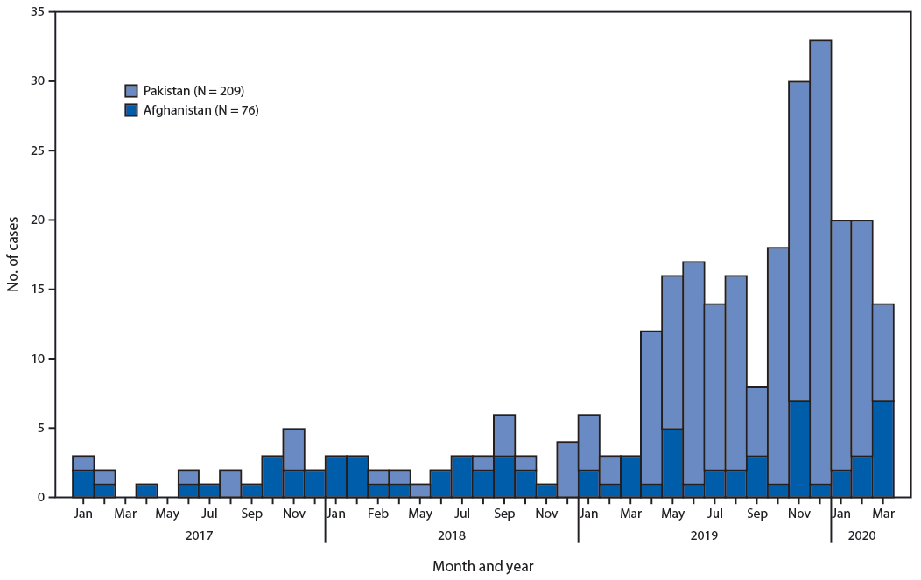
Image 1
Notes:
It is a bar graph visualization data
It is ADA compliant since all people even those with disabilities can access it
It is giving data regarding polio cases in Pakistan and Afghanistan where the cases have been unstable and rising
It uses bar graph data visualization method
Pie chart can also be used to produce visualization data

Slide 4
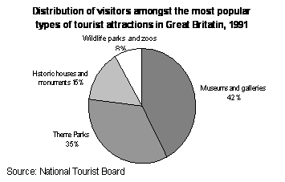
Image 2
Notes:
It is a pie chart visualization data
It is ADA compliant since all people even those with disabilities can access it
It is giving data regarding distribution of tourists among the various tourist attraction sites
It uses pie chart type visualization method
Bar graph can also be used to produce visualization data

Slide 5
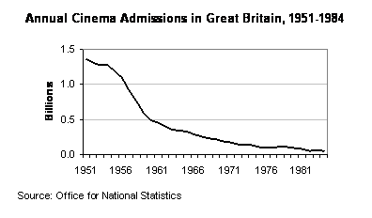
Image 3
Notes:
It is a line graph visualization data
It is ADA compliant since all people even those with disabilities can access it
It is giving data on annual cinema admissions in United Kingdom between 1951-1984
It uses line graph type visualization method
Pie chart can also be used to produce visualization data

Slide 6
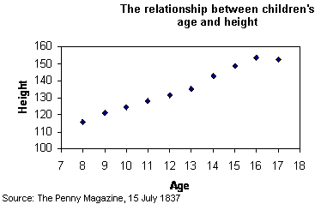
Image 4
Notes:
It is a scatter graph visualization data
It is ADA compliant since all people even those with disabilities can access it
It is giving data on relationship between children age and height
It uses scatter graph type visualization method
Histogram can also be used to produce visualization data

Slide 7
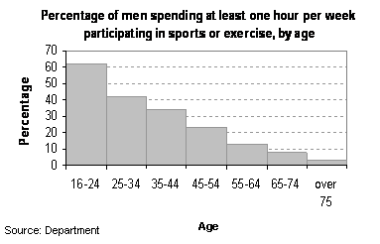
Image 5
Notes:
It is a histogram visualization data
It is ADA compliant since all people even those with disabilities can access it
It is giving data regarding percentage of men spending at least one hour per week participating in sports or exercise by age
It uses histogram type visualization method
Line graph can also be used to produce visualization data

Slide 8
Summary
Image 1: Bar graph
Image 2: Pie chart
Image 3: Line graph
Image4 : Scatter graph
Image 5 : Histogram

Slide 9
References
https://www.cdc.gov/
https://www2.le.ac.uk/offices/ld/all-resources/numerical-data/numerical-data

